Slide 1
CMPE 321
Examples

Slide 2
Question 1
A sequential circuit has two D flip-flops A and B, two inputs x and y , and one output z.
The flip-flop input equations and the circuit output are as follows:
Db = x'y + xA
Da = x'B + xA
z = B
a. Draw the logic diagram of the circuit.
b. Tabulate the state table.

Slide 3
Question 2
Design a 2-bit count-down counter.
This is a sequential circuit with two flipflops and one input x.
When x =0, the state of the flipflops does not change. When x = 1, the state sequence is 11, 10, 01, 00, 11, and repeat.

Slide 4
Question 3
Design a sequential circuit with two J-K flipflops.
A and B and two inputs E and X.
If E=0, the circuit remains in the same state regardless of the value of X.
When E=1 and X=1, the circuit goes «down» through the state transitions from 00 to 11 to 10 to 01 back to 00, the repeating.
Note that if E=1 and complement value of the previous X input is applied, the counter can be used to count up/down first, then count down/up.
Please draw this circuit using to D flipflops by converting J-K to D type.

Slide 5
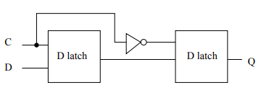
Question 4
Consider the falling edge triggered D flip-flop
(a) Suppose we replaced the first D-latch of the flip-flop by an AND gate. Would this circuit be equivalent in behavior to the D flip-flop ? If not, then why not?
(b) What if we instead replaced the second D-latch in the flip-flop by an AND gate. Would this circuit now be equivalent to the above D flipflop? If not, then why not?

Slide 6
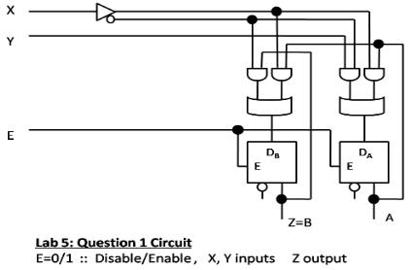
Answer 1 - a

Slide 7
Answer 1 -b
Present A | Present B | Input X | Input Y | Next A | Next B | BOutput Z
0 | 0 | 0 | 0 | 0 | 0 | 0
0 | 0 | 0 | 1 | 1 | 0 | 0
0 | 1 | 1 | 0 | 0 | 0 | 0
0 | 1 | 1 | 1 | 0 | 0 | 0
1 | 0 | 0 | 0 | 0 | 0 | 0
1 | 0 | 0 | 1 | 1 | 0 | 0
1 | 1 | 1 | 0 | 1 | 1 | 1
1 | 1 | 1 | 1 | 1 | 1 | 1

Slide 8
Answer 2 State Table
Present A | Present B | Input X | Next A | Next B
0 | 0 | 0 | 0 | 0
0 | 0 | 1 | 1 | 1
0 | 1 | 0 | 0 | 0
0 | 1 | 1 | 0 | 0
1 | 0 | 1 | 0 | 1
1 | 1 | 0 | 1 | 1
1 | 1 | 1 | 1 | 0

Slide 9
Answer 2 Boolean Equation
A(Next) = X’A + X(AB+ A’B’)
B(Next) = X’B + XB’

Slide 10
Asnwer 3 State Table
Present A | Present B | Input X | Next A | Next B
0 | 0 | 0 | 1 | 1
0 | 0 | 1 | 0 | 1
0 | 1 | 0 | 0 | 0
0 | 1 | 1 | 1 | 0
1 | 0 | 0 | 0 | 1
1 | 0 | 1 | 1 | 1
1 | 1 | 0 | 1 | 0
1 | 1 | 1 | 0 | 0

Slide 11
Answer 3 Boolean Equation
A(Next) = EX’ (AB + A’B’) + EX(AB’ +A’B) + E’ A
B(Next) = EB’ + E’B

Slide 12
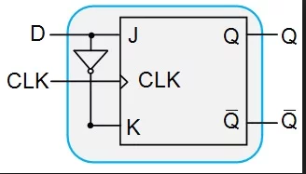
Answer 3 Converting JK to D Type
By connecting the expression outputs to the J-input, and the complement of the expression to the K-input, you basically transform the JK to a D type flip-flop.

Slide 13
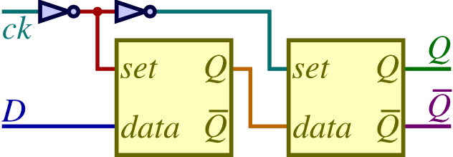
Answer 4 master-slave flip-flop
It uses two D latches; the first is called the master, while the second is called the slave.
The idea here is that as long as ck is 0, the set input into the master latch will be 1, and so the master latch will update to the current value of D.
When ck change s to 1, though, the set input to the slave latch becomes 1,
and so it receives the current value of the master latch, which will be the current value of D at that time.
At the same time, the set input to the master latch changes to 0,
so later updates to D will not have any effect on the master latch's remembered value,
and so the slave latch will continue to hold the value of D at the time ck changed from
0 to 1.

Slide 14
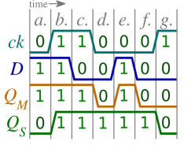
Answer 4
This process is summarized by the following timing diagram, which includes Q_{M} to represent the value remembered by the master latch (the first one) and Q_{S} to represent the value remembered by the slave latch (the second one).
A)If we chanege master with AND gate:

Slide 15
Answer 4
B) What if we use AND gate instead of the slave?

Slide 16
References
http://cs265.rkent.myweb.cs.uwindsor.ca/lab05w2009answers.html
http://personal.stevens.edu/~bmcnair/SwTh-Sum04/
https://www.allaboutcircuits.com/technical-articles/conversion-of-flip-flops-part-iii/

